Slide 1
LENDING CLUB CASE STUDY SUBMISSION
-Adharsh Belagapu

Slide 2
Case Study Objectives
Identification of Loan Applicants’ pattern in taking the decision for loan approval
Understand the ‘Driving Factors’ or ‘Driver Variables’ behind Loan Default phenomena
Loan Lending Organizations may choose to utilize this knowledge for its portfolio and risk assessment of new loan applicants

Slide 3
Problem Solving Methodology
Understanding Dataset (Data Cleaning)
Understand the Business
Data Understanding
Deployment
Data Preparation
Data Cleaning
(Imputed the NA values for all the driver variables)
Data Preparation
Evaluation
Modeling
Exploratory Data Analysis (Performed Univariate, Univariate Segmented & Multivariate analysis)

Slide 4
Data Cleaning Steps
Delete columns: Delete unnecessary columns.
Remove outliers: Remove high and low values that would disproportionately affect the results of your analysis.
Missing values: Treat missing values with appropriate approach.
Duplicate data: Remove identical rows, remove rows where some columns are identical.
Filter rows: Filter by segment, filter by date period to get only the rows relevant to the analysis.

Slide 5
Data Analysis
The essence of the whole project is to analyze and understand how consumer attributes and loan attributes are influencing the tendency of defaulting.
We performed data cleaning and preparation on the Loan dataset:
→Imputed the NA values for all the variables
→Created two new columns:
1. Profit and Loss column
2. Ratio of funded amount and annual income
During univariate analysis we have created
→Histograms and Bar charts to check out the distribution of all the driver variables
→Box plots to detect the Outliers
→Performed the Multivariate analysis to understand how different variables interact with each other.

Slide 6
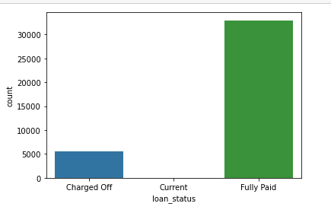
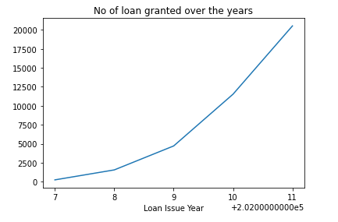
Loan Status Analysis
Observations:
Most of the loans are Fully Paid.
About 14% of loan are having status as defaulters.
The loan has been increasing exponentially over the years.

Slide 7
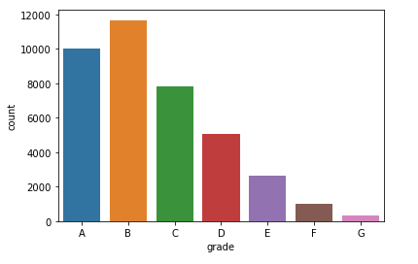
Loan Grade Analysis
Observation:
Most of the loans have grade of A and B. Therefore stating most of the loans are high graded loans.

Slide 8
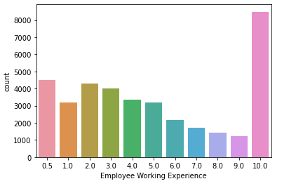
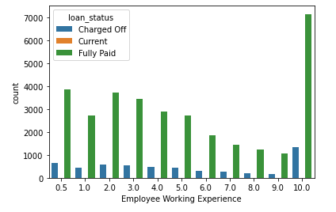
Loan Applicants work Experience Analysis
Observation:
1. Tendency of person to default the loan with 10 years of experience is also high. So company need to be careful when granting loan.
2. Majority of employees applying for the loan have more than 10 years of experience

Slide 9
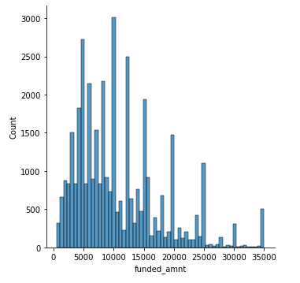
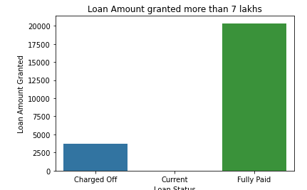
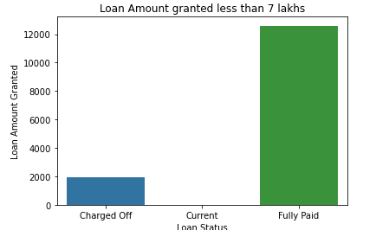
Loan Amount Analysis
Observation:
Funded amount is left skewed.
Most of the loan amount given is below 7 lakhs
More defaulters found in people taking loans more than 7 lakhs

Slide 10
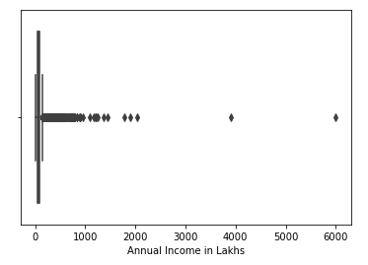
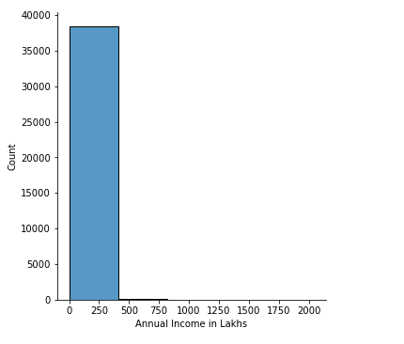
Income Analysis for the loan applicants
Observation:
Most of the applicants have income between 0 to 5 lakhs.
There are two applicants having income above 30 lakhs

Slide 11
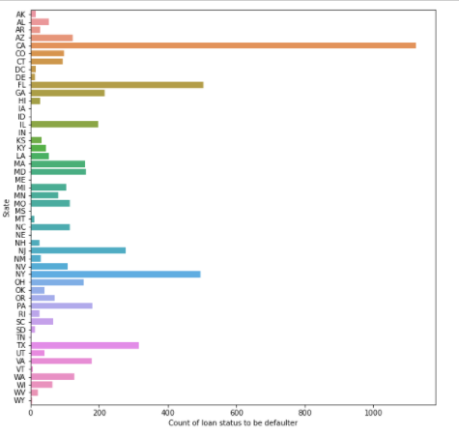
Loan Defaulters by State Analysis
Observation:
Applicants from state CA have high tendency to default the loan

Slide 12
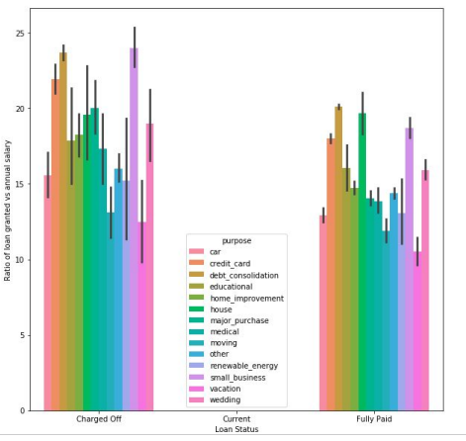
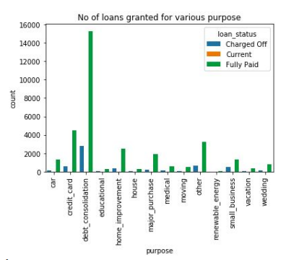
Purpose for applying Loan Analysis
Observation:
Most of the loans are granted were for debt consolidation.
Applicants having higher income tends to default the loan.

Slide 13
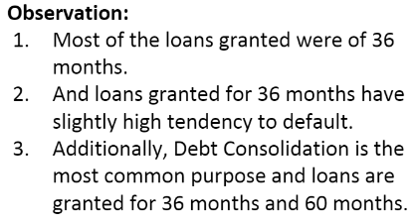
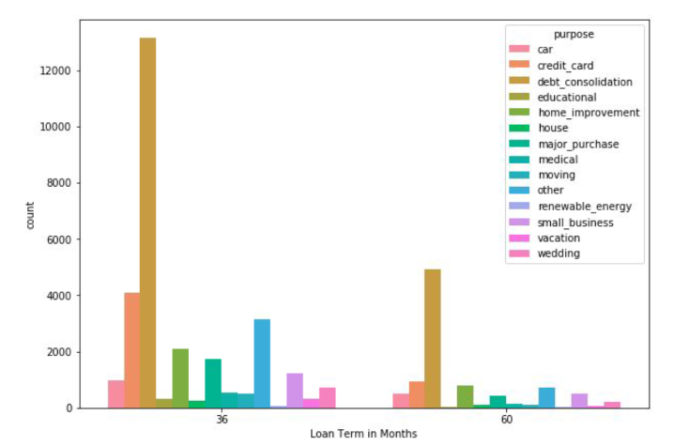
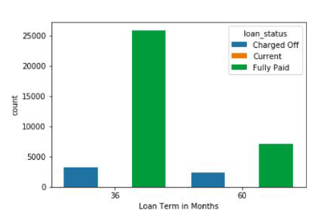
Loan Status vs Loan Tenure

Slide 14
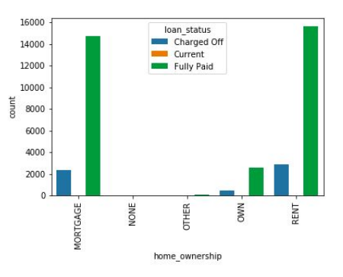
Loan Status by Home Ownership
Observation: Applicants having there home rented or on mortgage have almost equal tendency to default the loan.

Slide 15
Conclusion
Results
Low grade loans have high tendency to default. Grading system is working as expected.
Loans having higher interest rate have more defaulters. Check the background of applicant thoroughly if interest rate is high.
Extra scrutiny must be done for the applicants belonging to CA state, as tendency to default is high.
When the purpose is debt consolidation check applicant thoroughly as it has high tendency to default.

